Slide 1
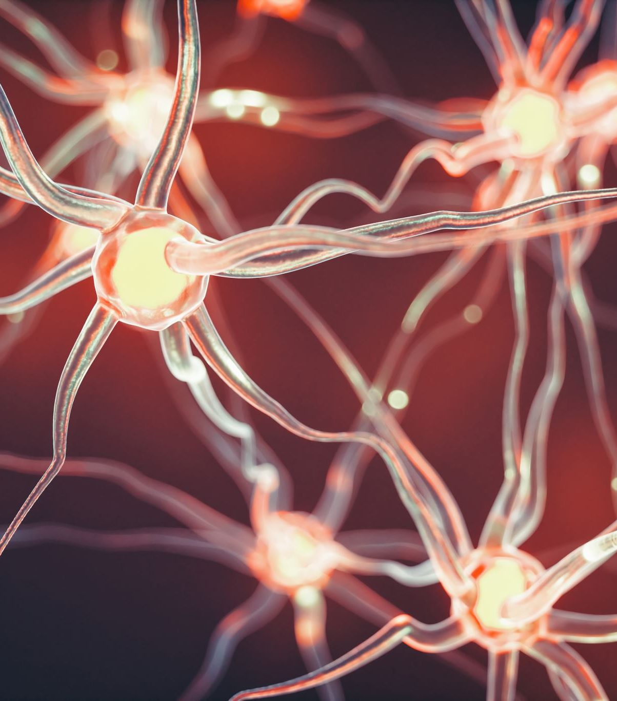
Hippocampal role in the interaction of semantic memory with learning and decision
Florian Leprévost
Prof. Dr. Bianca Wittmann
Justus-Liebig-Universität Gießen –
BION meeting 2022

Slide 2
1.1 Associative Inference
1. Introduction
A
B
A
C
B
C
Notes:
What is AI

Slide 3
1.1 Associative Inference
1. Introduction
State representation
OFC (Spalding 18, Jones 12)
OFC-hippocampus (Bowman)
Value computation
Striatum & VTA dopamine (RL)
Generalisation
OFC hippocampus (Schlichting 16)
Striatum- hippo FC (Wimmer 12)
Dopamine to MTL? (Kahnt 16)
Post or Ant Hippo?
Semantic association (Ryan et al., 2016)
Facilitates associative learning
But not if hippocampus lesion
HPC
(associated) state computation
associated value computation
OFC
St
generalisation?
reinforcement learning
VTA
Notes:
what processes/areas involved

Slide 4

How does semantic memory facilitate associative learning, and what role has the hippocampus in it?

Slide 5
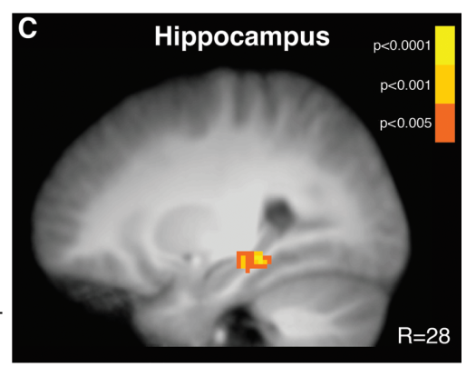
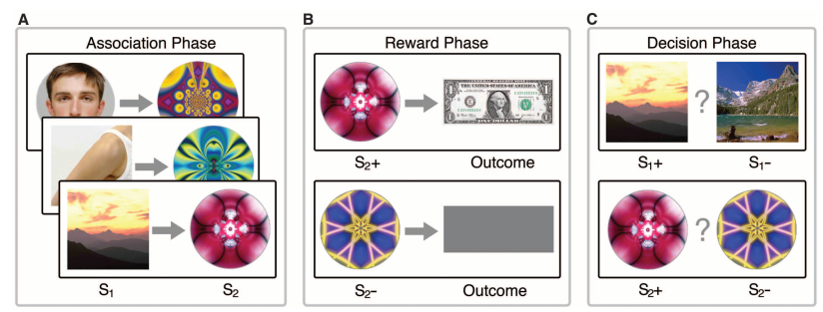
1.2 Paradigm
1. Introduction
Hippocampus activation during learning (A-B) predicts associative performance (in probe phase)
Wimmer & Shohamy 2012
Pre-conditioning Conditioning Probe
Less hippocampal involvement necessary for semantically linked pairs
Notes:
Example of xp based on this

Slide 6
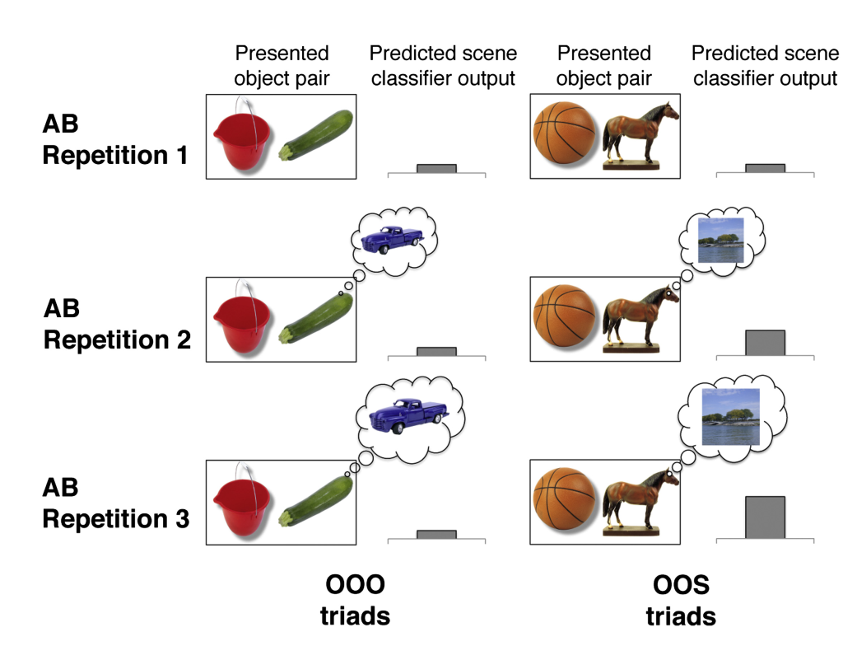
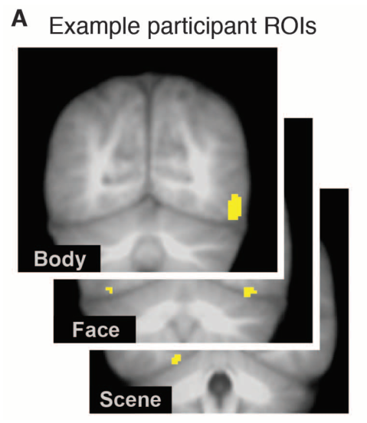
1.2 Paradigm
1. Introduction
Category specific visual areas
Train category classifier
Earlier greater classifier output for semantically linked objects

Slide 7
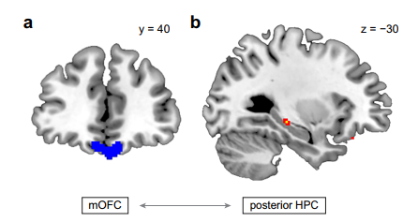
1.2 Paradigm
1. Introduction
OFC-hippo FC correls with reaction times during Probe phase (Wang)
Striatum- hippo FC during Conditioning phase correls with performance in Probe Phase (Wimmer)
Less hippocampal-OFC and functional connectivity necessary for semantically linked pairs (but not less hippo-striatum)

Slide 8
1. Introduction
1.3 Hypotheses
Hippocampal activity during Conditionning Phase doesn't predict performance for semantically linked pairs
Reactivation of the associated stim in ealier repetition for the semantically linked pairs
Reduced functionnal connectivity hippo-striatum and hippo-OFC (because hippo not necessary anymore to recover associated stimulus state)
+ Representational similarity in hippocampus higher for semantically linked pairs, and predictive of performance

Slide 9

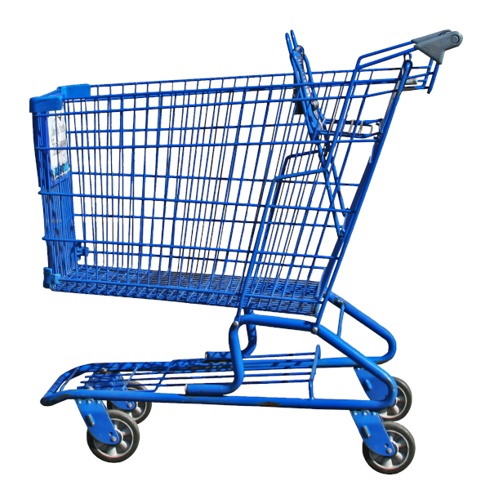

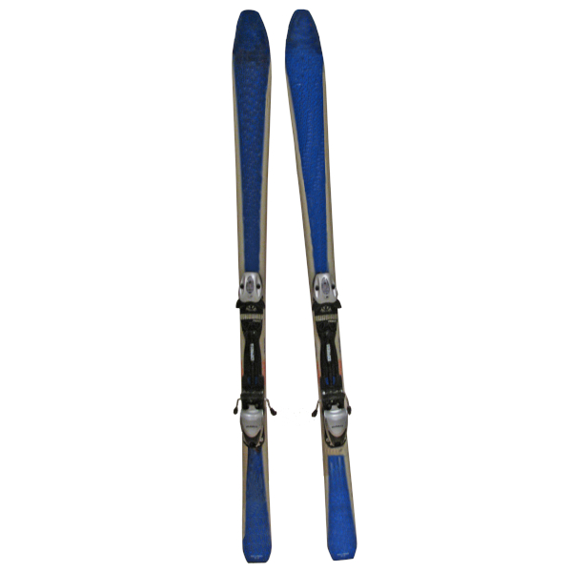




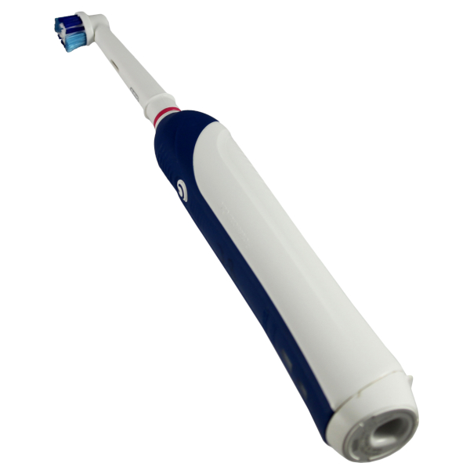

2.1 Design
2. Experiment
Semantic link
0 1
2 x 2
Semantic link
reward
0
Reward
1

Slide 10
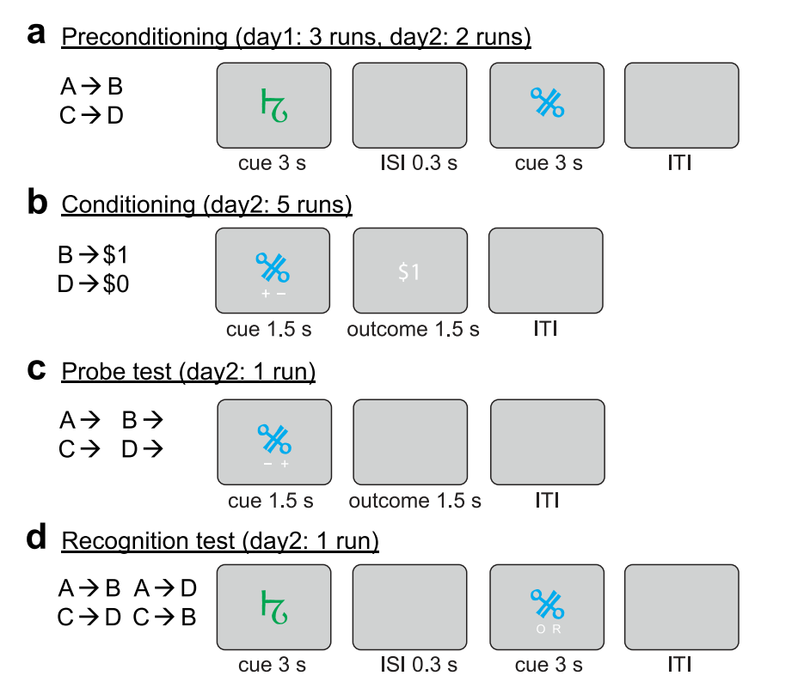
2.1 Design
2. Experiment
Pre-conditioning
Conditioning
Probe
Localizer
Distractor (avoid recency effects)
Memory

Slide 11
2. Experiment
2.2 Time course
Localizer
N-1 task
Preconditioning
16 S-O pairs, each repeated 6 times
Conditioning
Distractor task
Probe
Memory
~ 5 min
0,3s ITI + 2s stim * 13 rep * 8 block
~ 6,5 min
S1 1,5s + ISI 1s + S2 1,5s + ITI 2,5s

Slide 12


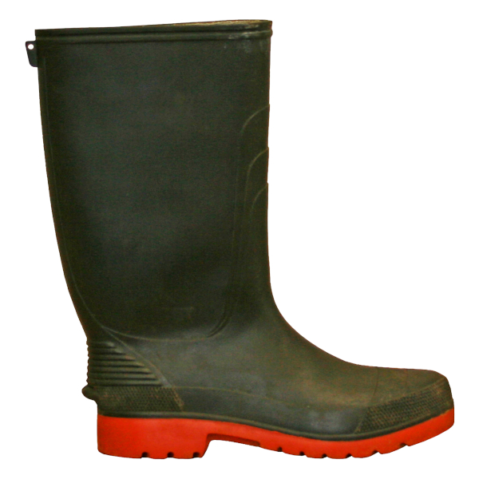

Slide 13
Wang et al. 2020

Slide 17
1.2 Paradigm – Reward & Decision Phases
1. Introduction
Reactivation in Reward phase predict performance in Decision phase (Wimmer)
Classifier trained to differentiate rewarded vs unrewarded stimuli during Reward phase can accurately classify Decision phase state in OFC (Wang)

Slide 18
Reactivation of associated stimuli with learning
1. Background
Greater learning-related hippocampal decreases (first - last parameter estimate) across encoding repetitions were associated with greater AC performance at test.
Greater activation increases in VMPFC (last-first parameter estimate) across encoding repetitions were associated with greater AC performance at test

Slide 19
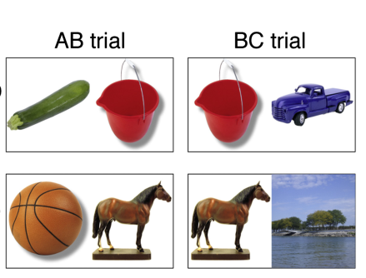
Reactivation of associated stimuli with learning
1. Background
Zeithamova et al 2012
Associative learning OOS
Category specific visual areas
Train category classifier

Slide 20
1.1 Associative Inference
1. Introduction
(V)MPFC-hippocampus for associative learning
Vmpfc helps (bad if lesion Spalding 2018), sadacca 2018, Hart 2020
Wikenheiser 2017 = hippo inactivation less state rpz in OFC
Dopamine helps (Lee 2021 , Clos 2019)
Role for midbrain dopamine (Shohamy 2018,, 2016)?
Kahnt 2012 FC striqtum hippo imp for généralisation
hPC-mpfc coupling during BC learning, Schlichting 2016
Jones 2012
Striatum – VTA for reinforcement learning
Anterior vs posterior hippocampus? (post H for généralisation vs ant Cowan21, wang21 but schlichting 15 poppenk 2013 milivojevic15 separation)
Anterior H for asso, giovanello 2004
Ant H configural strategy Duncan 2018
Ant H généralisation, Schlichting 2015
Ant H VTA coupling for novelty Cowan 2021
Ant H rpz prototype vs exemplar Bowman 2018
Ant H + episodiv vs post retrieval? Wang 2021
Ant H = pattern separation of non associated memory (RSA) Schlichting 2015
preexisting semantic associations seem to facilitate associative learning, but not for people with hippocampal lesions (Ryan et al., 2016, Pajkert 2017)
New = semantic link between A & B
Already existing link in hippocampus?

Slide 21
Reactivation of associated stimuli with learning
1. Background
Greater learning-related hippocampal decreases (first - last parameter estimate) across encoding repetitions were associated with greater AC performance at test.
Greater activation increases in VMPFC (last-first parameter estimate) across encoding repetitions were associated with greater AC performance at test

